Slide 1
Workcase 3
Виконали: Чех І. В. та Дзизиль Д.Є.

Slide 2
Cloning your virtual working OS

Slide 3
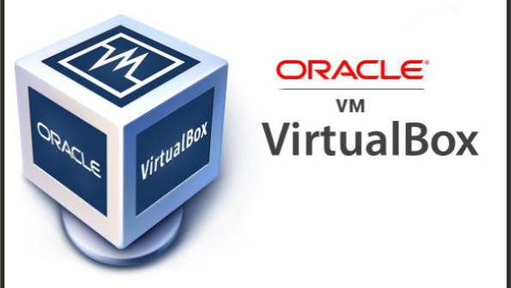
01
'Clone a virtual machine'
Виконав студент: Дзизиль Д.Є.

Slide 4
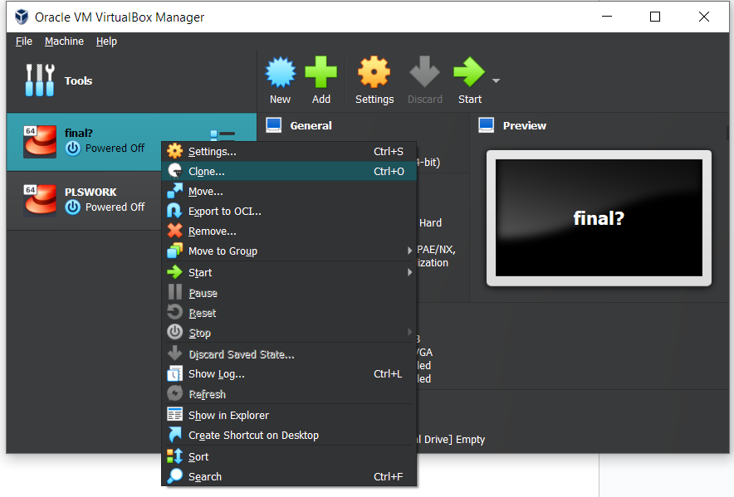
Cloning
Виконав студент: Дзизиль Д.Є.
01
In order to clone a virtual machine, you must:
Start the Virtual Box program;
Right-click on the machine to be cloned and click “Clone”;
Next, you need to configure the clone: name the cloned machine, choose the folder where it will be stored and other options;

Slide 5
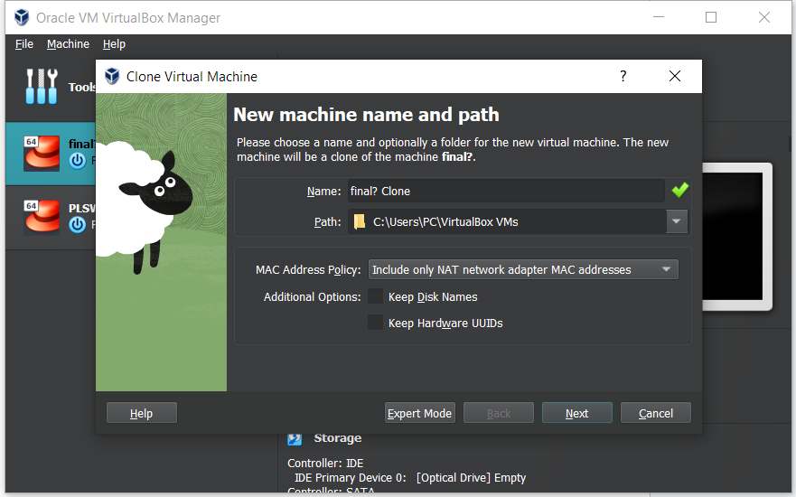
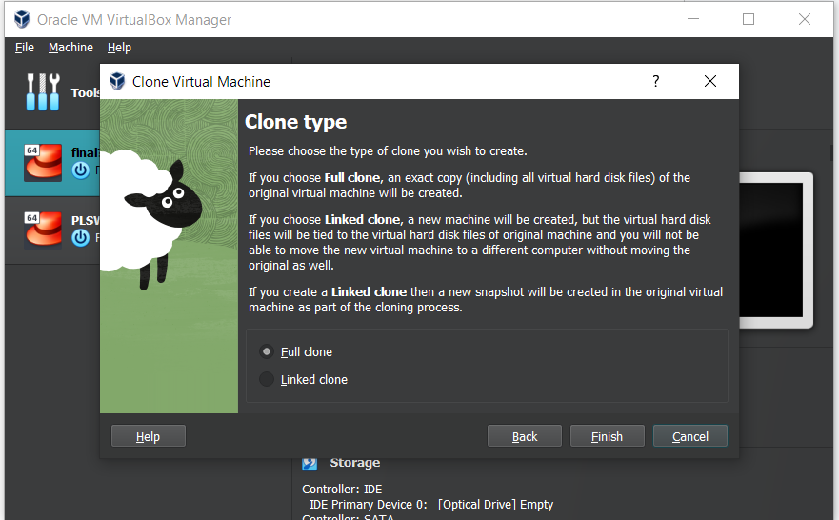
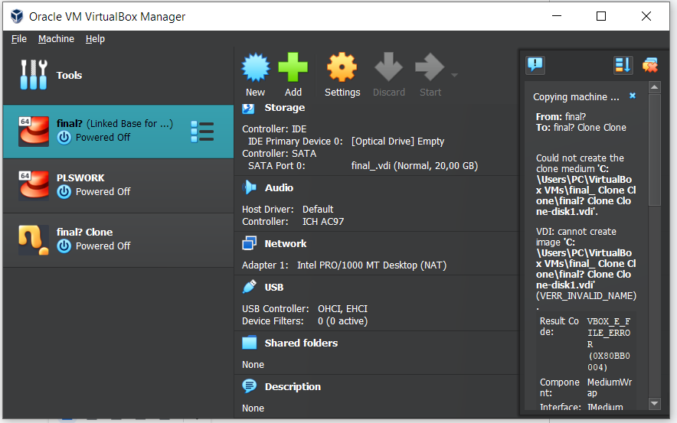
Виконав студент: Дзизиль Д.Є.
01

Slide 6
01
'Export'
Виконав студент: Дзизиль Д.Є.

Slide 7
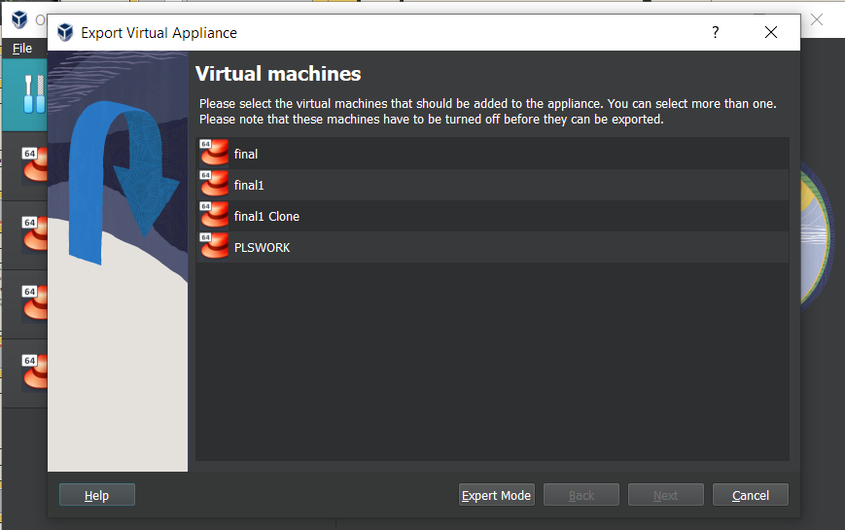
Export
Виконав студент: Дзизиль Д.Є.
01
In order to export a virtual OS, you must:
Select the virtual OS you want to export;
Click on the "Tools" button, then on "Export";
Next, it is necessary to configure the export parameters of the virtual OS;

Slide 8
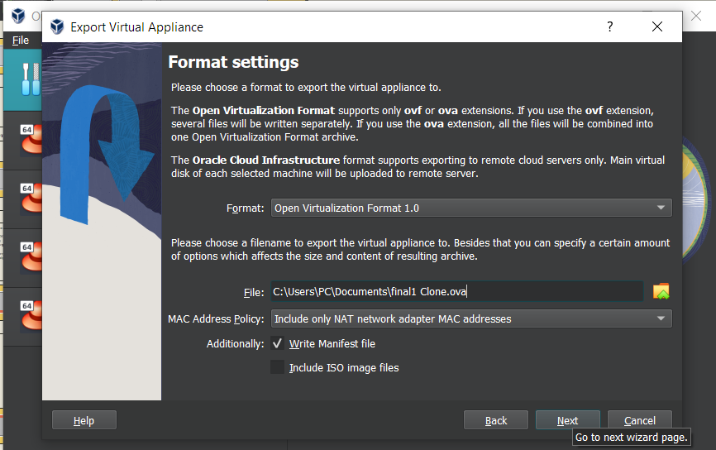
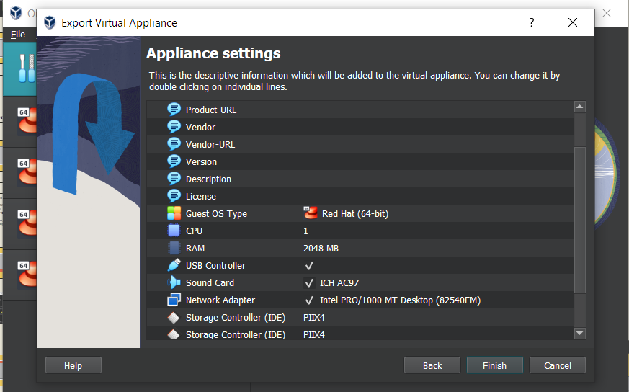
Виконав студент: Дзизиль Д.Є.
01

Slide 9
Describe what types of organization of network connections are supported in the environment of virtual machines, what is the peculiarity of each of them:

Slide 10

Network Address Translation (NAT):
Feature: In NAT mode, VirtualBox creates an internal network for virtual machines and uses NAT to establish connections with the external network. Each virtual machine is assigned an IP address in this internal network, and access to the internet and other resources of the external network is facilitated through NAT.
Purpose: It is used when you want your virtual machines to have access to the internet or other external network resources but do not require public IP addresses.
Виконав студент: Чех І. В.

Slide 11

Network bridge:
Feature: In Bridged mode, the virtual machine is connected directly to the physical network, like other computers on your local network. It receives its own IP address from the local network and can communicate with other devices on this network.
Purpose: Used when you need a virtual machine to be fully visible and accessible on the local network like any other physical computer.
Виконав студент: Чех І. В.

Slide 12

Virtual host adapter (Host-only):
Feature: In Host-only mode, virtual machines can communicate only with each other and with the host system, but do not have access to an external network or the Internet. They get IP addresses from the internal virtual network.
Purpose: Used when you need to create an isolated network for internal testing or development and you do not want the virtual machines to have access to the external network.
Виконав студент: Чех І. В.

Slide 13
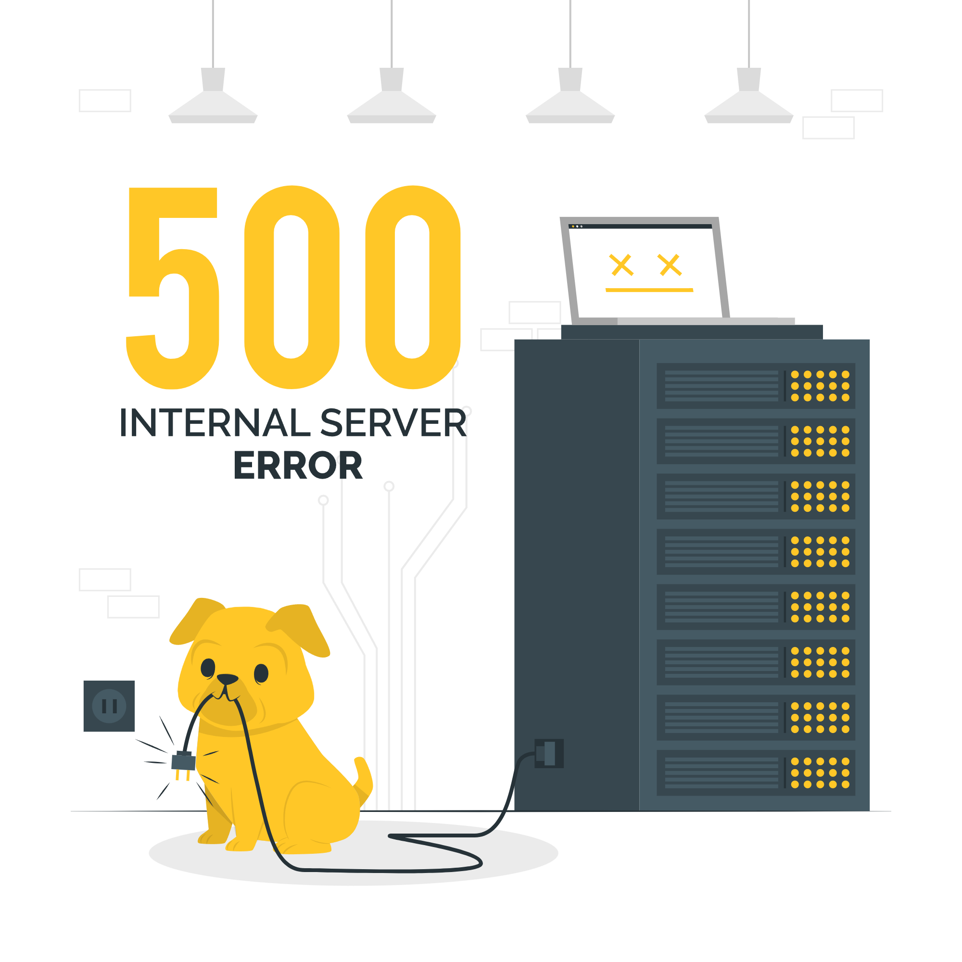
Internal network:
Feature: In Internal Network mode, virtual machines connect to an internal network and can only communicate with each other and with the host system, if such a network is configured. They do not have access to an external network or the Internet.
Purpose: Used when you need to create a closed internal network for virtual machines that must communicate with each other but must not be accessible from the outside.
Виконав студент: Чех І. В.

Slide 14
03
'Configuring network settings'
Виконав студент: Чех. І.В.

Slide 15
Network settings
Виконав студент: Чех. І.В.
03
There are the following commands for configuring the network:
Ifconfig - This command displays the current settings of network interfaces, such as IP address, subnet mask, and more. It also allows you to change network settings;
Ip — is a more modern alternative to "ifconfig";
Route (route) — this command displays and allows you to change routing tables;

Slide 16
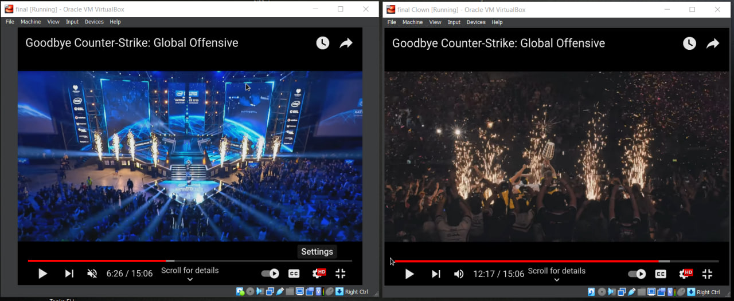
Network settings
Виконав студент: Чех. І.В.
03

Slide 17
03
'Inter-OS Messaging'
Виконав студент: Чех. І.В.

Slide 18
Exchange of messages between OS
Виконав студент: Чех. І.В.
03
First, start one virtual machine listening on a specific port: Nc –l –p 12345;
On another virtual machine, you need to write the following command:
Nc <IP address> 12345;
After entering this command, you will be able to enter a text message and it will go to the other machine
To exit press “Ctrl+C”;

Slide 19
03
‘Network Folder'
Виконав студент: Чех. І.В.

Slide 20
Network Folder
Виконав студент: Чех. І.В.
03
Install the "cifs-utils" package if it is not already installed: sudo apt install cifs-utils
Create a directory in which you will mount the shared folder: mkdir ~/shared_folder
Mount the shared folder using the "mount.cifs" command. Replace <IP_address> and <folder_name> with the appropriate values: sudo mount -t cifs //<IP_address>/<folder_name> ~/shared_folder -o username=<your_name>,password=<your_password>
Now that you've set up a shared folder, you can copy files between that folder and your home directories on both operating systems.

Slide 21
04
‘Sharing audio-file'
Виконав студент: Дзизиль Д.Є.

Slide 22
Sharing audio-file
Виконав студент: Дзизиль Д.Є.
04
To exchange information between your main operating system and Linux virtual operating systems, you can use different methods, such as shared folders (Shared Folders) in virtual programs, SSH, Samba, or FTP. One of the easiest ways is to use SSH to connect between OSes.
Configure SSH on the Linux virtual machine:
Install an SSH server on your Linux virtual machine if not already done. You can do this using your Linux distribution's package manager. For example, for Ubuntu it looks like this: sudo apt-get install openssh-server
After installing SSH, verify that the SSH service is running on your virtual machine: sudo systemctl status ssh

Slide 23
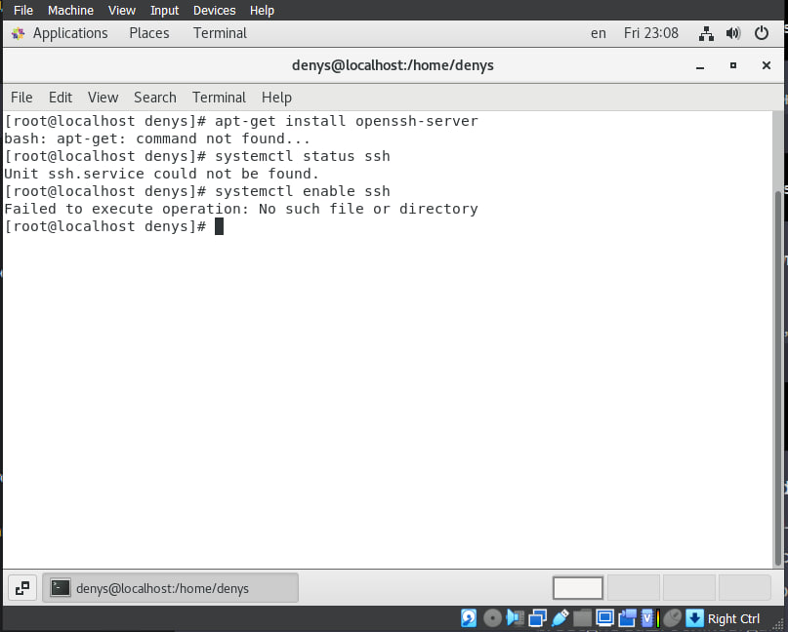
Sharing audio-file
Виконав студент: Дзизиль Д.Є.
04

Slide 24
Sharing audio-file
Виконав студент: Дзизиль Д.Є.
04
If necessary, enable the SSH service: sudo systemctl enable ssh
After installing SSH, verify that the SSH service is running on your virtual machine: sudo systemctl status ssh
Find the IP address of the Linux virtual machine:
Start your Linux virtual machine and open a terminal.
Enter the following command to find the IP address of the virtual machine: ip a
Copy an audio file from Windows to a Linux virtual machine:
a. From your primary operating system (Windows), use an SSH client (such as PuTTY or Windows PowerShell) to connect to the Linux virtual machine using its IP address and SSH port (usually 22).

Slide 25
Sharing audio-file
Виконав студент: Дзизиль Д.Є.
04
If necessary, enable the SSH service: sudo systemctl enable ssh
After installing SSH, verify that the SSH service is running on your virtual machine: sudo systemctl status ssh
Find the IP address of the Linux virtual machine:
Start your Linux virtual machine and open a terminal.
Enter the following command to find the IP address of the virtual machine: ip a
Copy an audio file from Windows to a Linux virtual machine:
From your primary operating system (Windows), use an SSH client (such as PuTTY or Windows PowerShell) to connect to the Linux virtual machine using its IP address and SSH port (usually 22).

Slide 26
Sharing audio-file
Виконав студент: Дзизиль Д.Є.
04
Enter your Linux user credentials and password that you use to log in to the virtual machine.
Once logged in, use the scp or sftp commands to copy your audio file from Windows to the Linux virtual machine.
Example: From Windows PowerShell:
scp C:\шлях_до_аудіо_файлу.mp3 username@ip_virtual_machine:/home/username/
Do the reverse to copy the file from the Linux virtual machine to your main operating system:
Use the SCP or SFTP commands to copy the file from the Linux virtual machine to your host operating system.

Slide 27
Sharing audio-file
Виконав студент: Дзизиль Д.Є.
04
From Windows PowerShell: scp username@ip_віртуальної_машини:/home/username/аудіо_файл.mp3 C:\куди_скопіювати\
This method allows you to securely and efficiently share files between Windows and Linux using an SSH connection. Be careful when using SSH, and make sure you know the credentials to access your Linux VM.

Slide 28

Conclusion: in the process of doing this work, we learned how to clone a virtual machine, export a virtual machine, understand the differences between broad types of network connections, learn how to expand network folders, transfer audio files between OSes.

